Slide 1



Design and Characterization of Liquid Fuel Spray Injector
Rebekah Weigand
Mentor: Dr. Elliott Bryner
2022 Arizona Space Grant Symposium
April 22-23, 2022

Slide 2
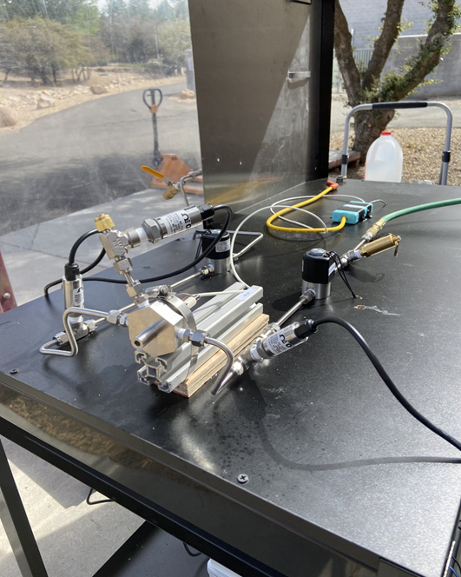
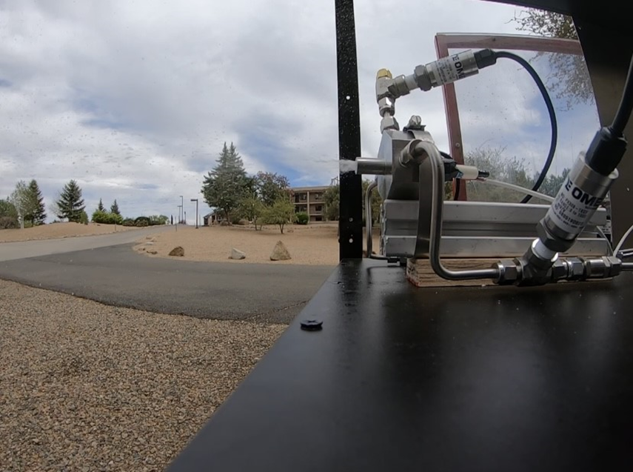
Background: Previous Work
Spray during cold flow test. Water and gaseous oxygen are entering the combustion chamber perpendicular to each other.

Slide 3
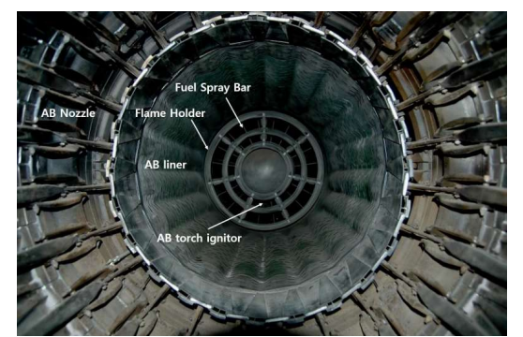
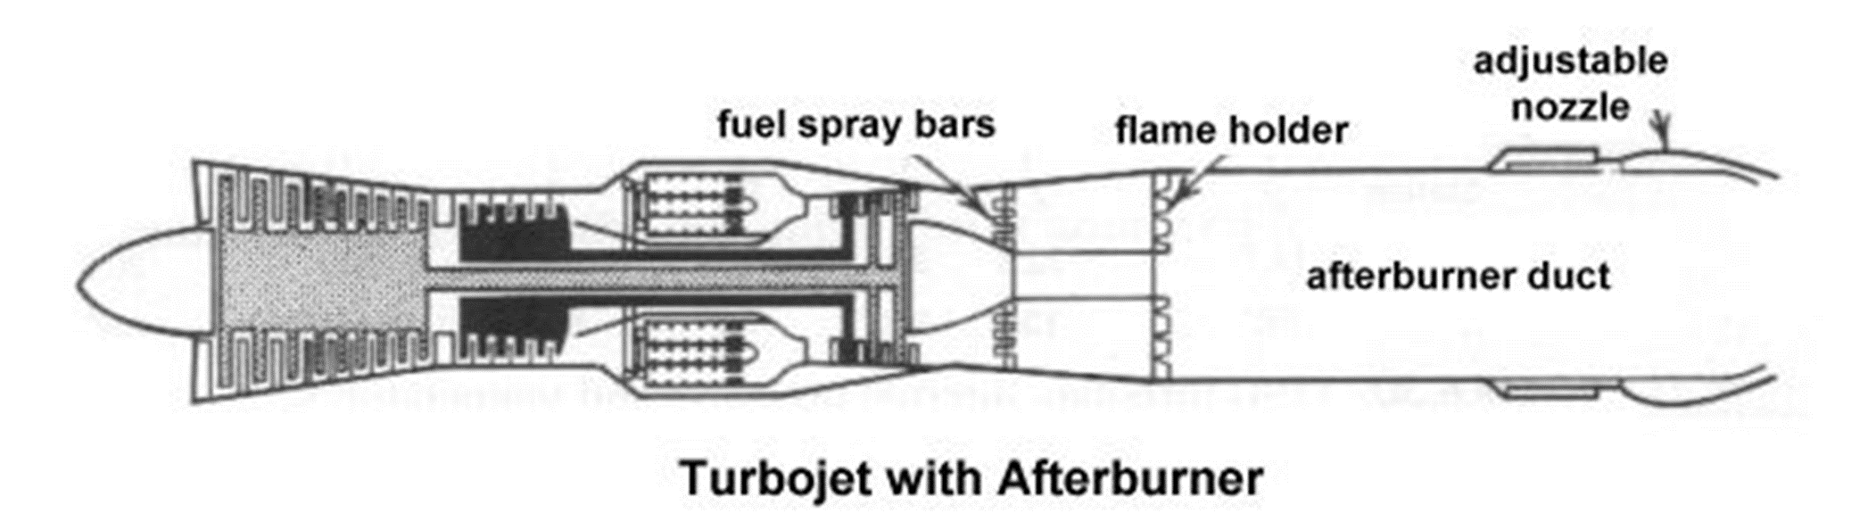
Background: Afterburner Components
Courtesy of AerospaceWeb.org, 2001
J-85 Flame Holder
Courtesy of Austin Childers, 2020

Slide 4
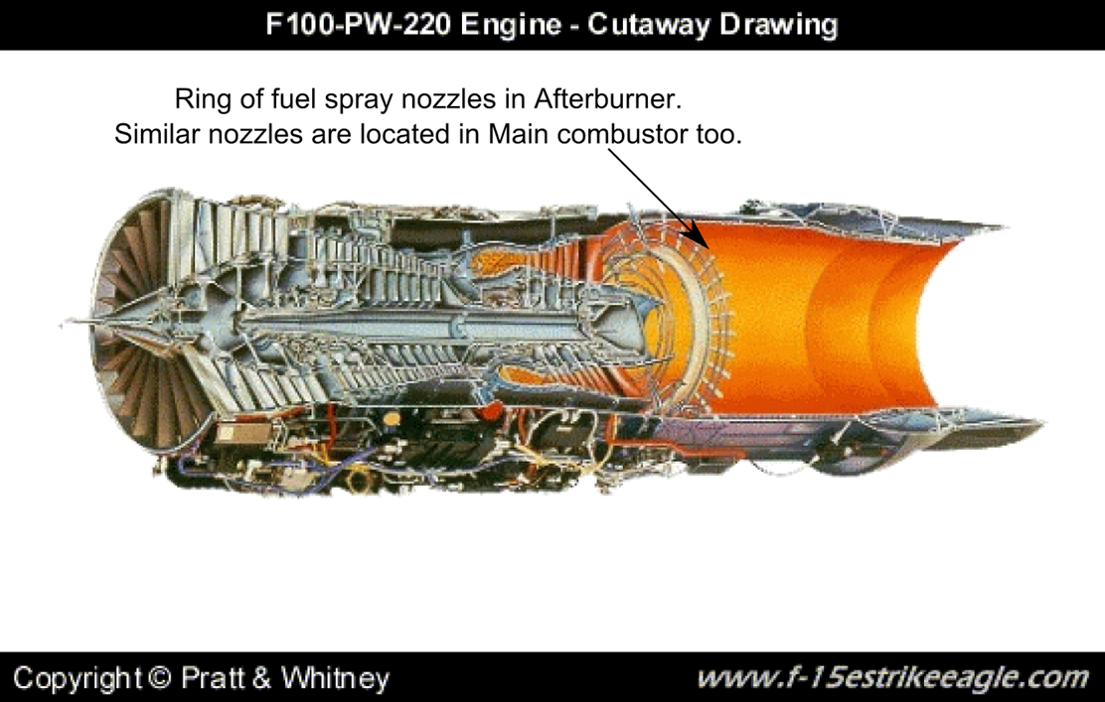
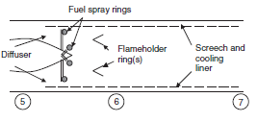
Background: Afterburner Components
Courtesy of Farokhi, Aircraft Propulsion, pg 199, 2014
Courtesy of Pratt & Whitney

Slide 5
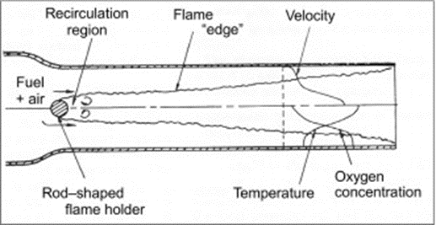
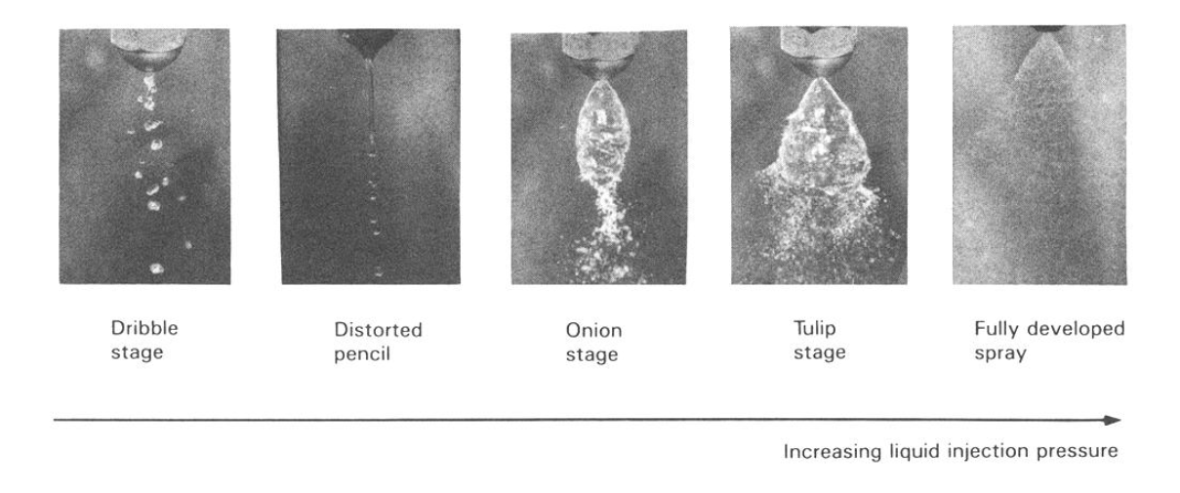
Background: Fuel Spray Nozzles and Atomization
Courtesy of Brian Spalding, 2013
Courtesy of Atomization and Sprays, pg. 78, 1989

Slide 6
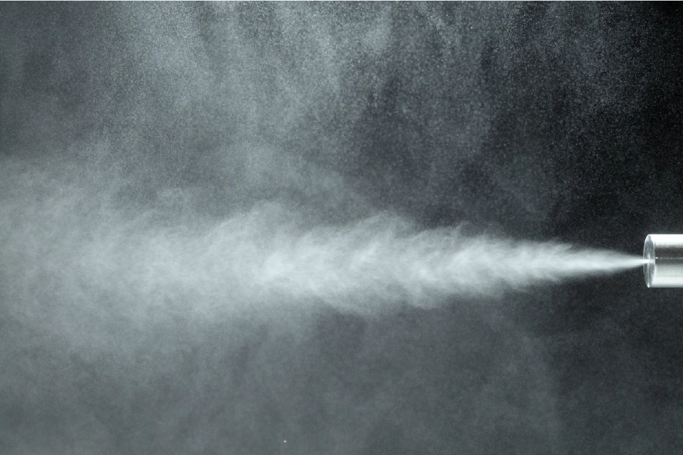
Objective
Analyze the injection and mixing zone of an afterburner
Characterize the atomization and spray distribution of injected fuel droplets
Courtesy of John Stevenson, 2011

Slide 7
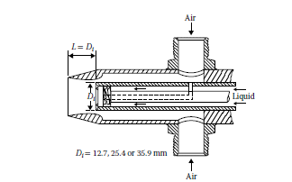
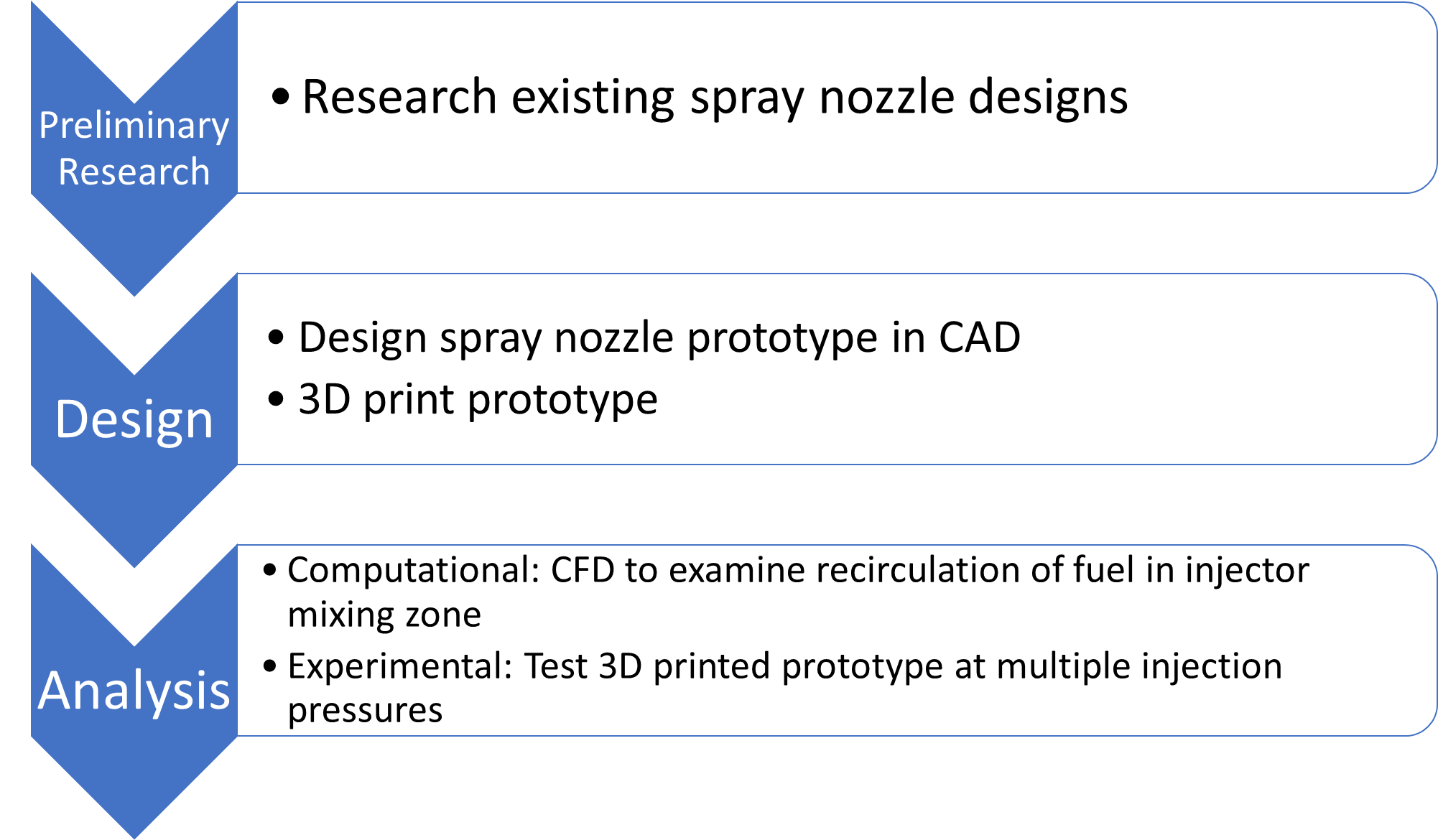
Methods
Courtesy of Atomization and Sprays, pg. 91, 1989

Slide 8
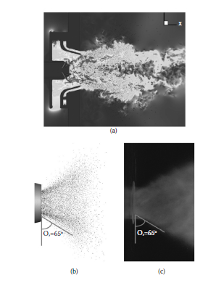
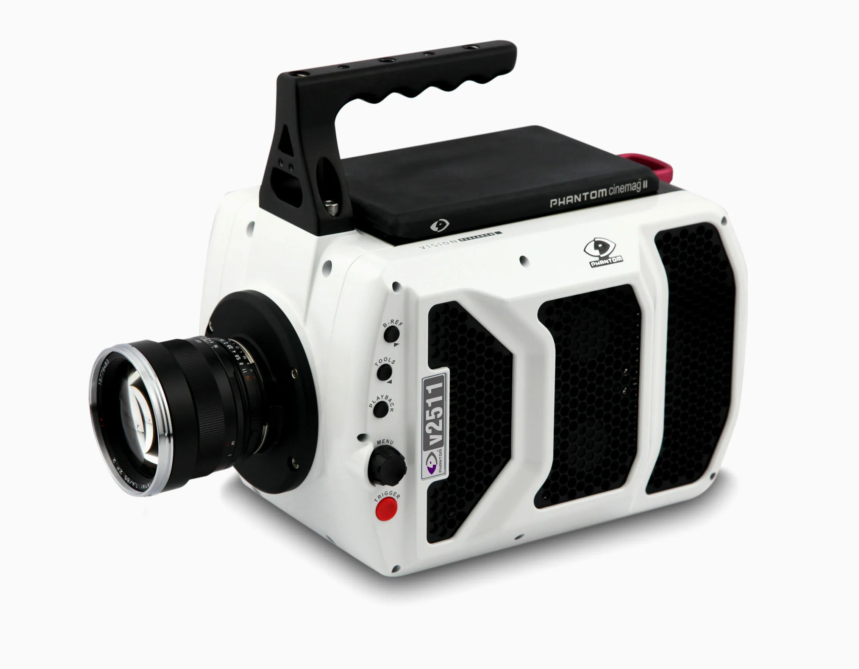
Future Goals
Complete CFD analysis
Test prototype at various injection pressures
Examine atomization and spray distribution of fuel using high-speed camera
Courtesy of Phantom Cameras
Courtesy of Li, X. et al. J. Eng. Gas Turbines Power, 136, 2014

Slide 9
Acknowledgements
Arizona Space Grant through the Undergraduate Research Institute
Faculty advisor: Dr. Elliott Bryner
College of Engineering at Embry-Riddle Aeronautical University-Prescott

Slide 10
Thank you.
Questions?

